Slide 1
From Association to Modelling Causality
PSYC 234 Week 11 January 2025
Dr. Emma Mills
e.mills@lancaster.ac.uk

Slide 2
Benefits of Regression:
Flexibility

Slide 3
Benefits of Regression:
Flexibility
Statistical Power

Slide 4
Benefits of Regression:
Flexibility
Statistical Power
Predictions

Slide 5
Benefits of Regression:
Flexibility
Statistical Power
Predictions
Extensions

Slide 6
At what cost?
More variables – more complexity in understanding the model
Data preparation may be more indicated

Slide 7
At what cost?
More variables – more complexity in understanding the model
Data preparation may be more indicated
The intercept term

Slide 8
At what cost?
More variables – more complexity in understanding the model
Data preparation may be more indicated
The intercept term
Reference levels

Slide 9
At what cost?
More variables – more complexity in understanding the model
Data preparation may be more indicated
The intercept term
Reference levels
Understanding how the variables work together or making predictions
get ready to some maths

Slide 10
Weeks 11 - 15
Continuation of learning from PSYC 122
Correlation, Simple regression, Multiple Regression
Deeper Dive into multiple regression methods
Categorical and continuous variables
Variables with more than three levels
Strategies to help interpretation when the model summary looks strange
Interactions in the linear regression model
Mediation models
Variable reduction using Factor Analysis methods

Slide 11
Weeks 15 – 19 with Dr Amy
Non-parametric methods
Logistic regression
Ordinal regression

Slide 12
Week 20
Class test – 100% of course assessment
58 Multiple choice Qs
12 Qs related to some coding in R with interpretation for answering questions
2 hours (longer for those with adapted assessment arrangements)
Tuesday, 18th March, 2025, 9:00 am
Across several venues - check your timetable for your venue.

Slide 13
Formative Assessment
Web Based Quizzes
To help you both understand what you know and what you don’t yet know
Each week’s quiz relates to lecture content
Supporting text:
Howell, D. C. (2017). Fundamental statistics for the behavioral sciences (Ninth edition.). Cengage.
Chapters 9, 10 and 11; working through those will consolidate the points in lectures and learning in labs – I can help with checking answers to questions (Just give me some notice that you would like that).

Slide 14
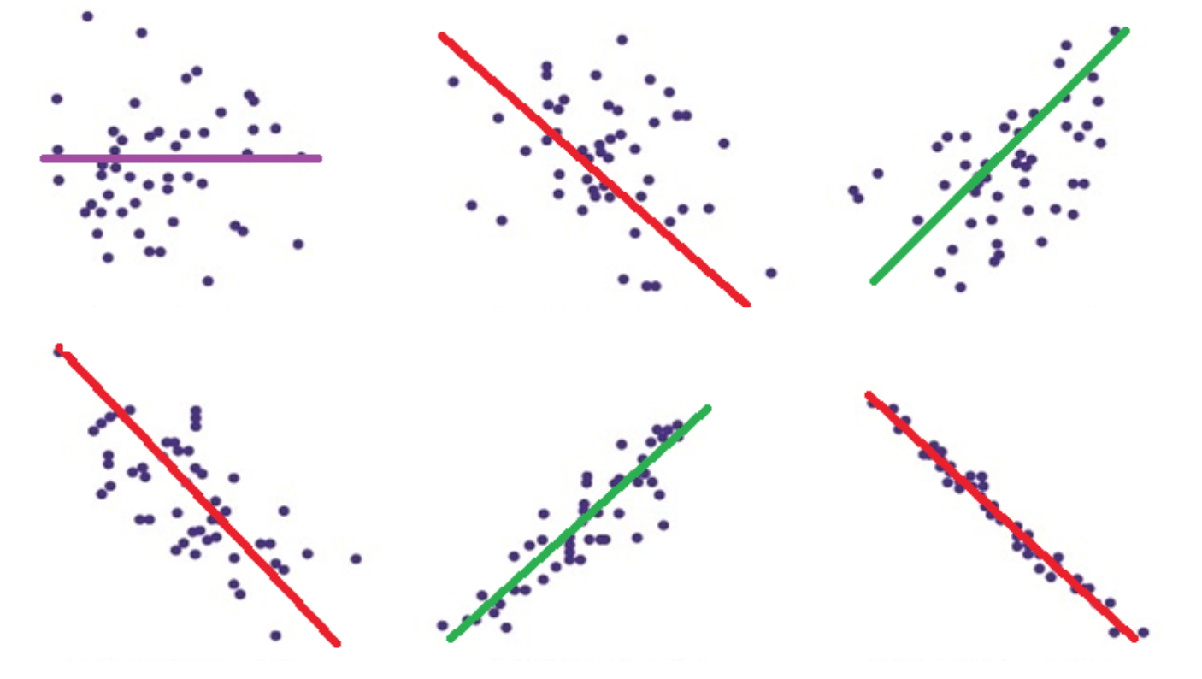
Review: Correlation: Pearson’s r
The strength and direction of the relationship between two continuous variables
Values between -1 and 1

Slide 15
Review: Correlation:
X₁
X₂
X₁
X₁
X₂
X₂

Slide 16

Review: Correlation: Pearson’s r: Mathematical Formula
$$covariance= \frac{Σ\left(X_{1} − \overline{X_{1}}\right)∗\left(X_{2} − \overline{X_{2}}\right)}{N−1}$$
$$r= \frac{covariance}{SD\left(X_{1}\right)∗SD(X_{2})}$$

Slide 17
Review: Correlation: Pearson’s r: Assumptions
Interval scale variables
Full data
Variables are normally distributed (hint: qq-plots)
The relationship is linear
Not curvilinear
Constant variance – or homoscedasticity

Slide 18
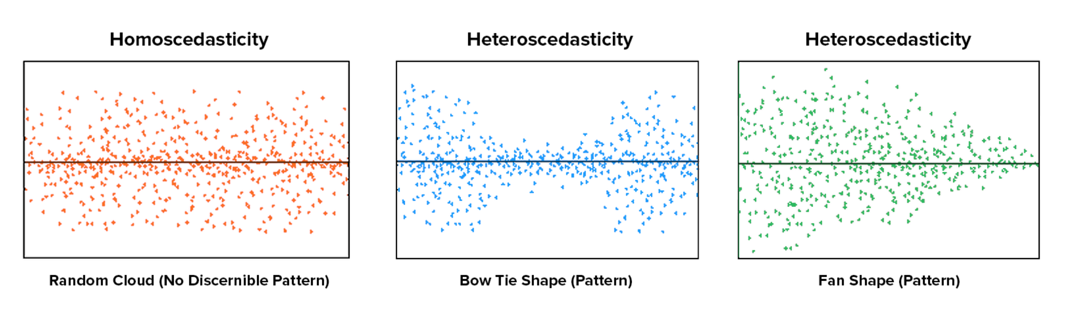
Review: Correlation: Pearson’s r: Assumptions
Homoscedasticity…

Slide 19
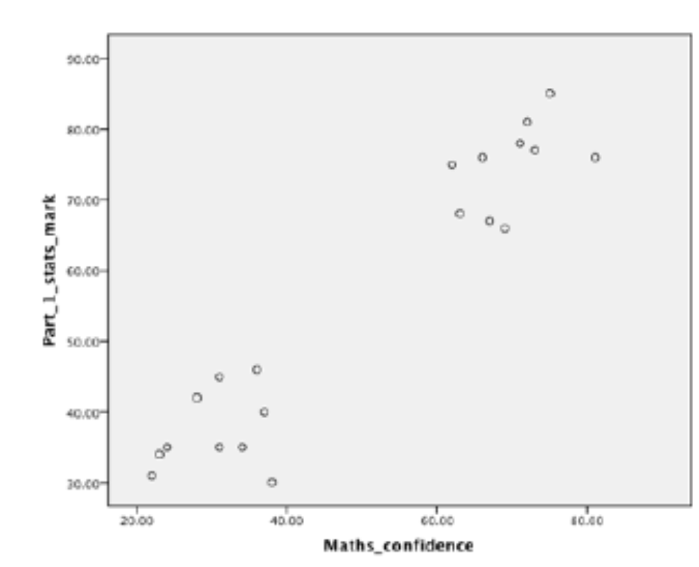
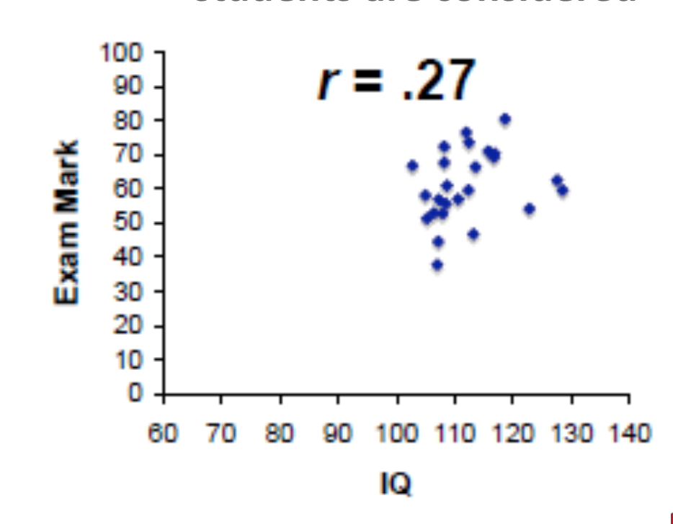
Review: Correlation: Pearson’s r: Threats to Measurement Precision
Outlier datapoints
Range restriction:
Using a sample that is not representative of the possible range of scores
Using a sample that actually seems to be two distinct groups

Slide 20
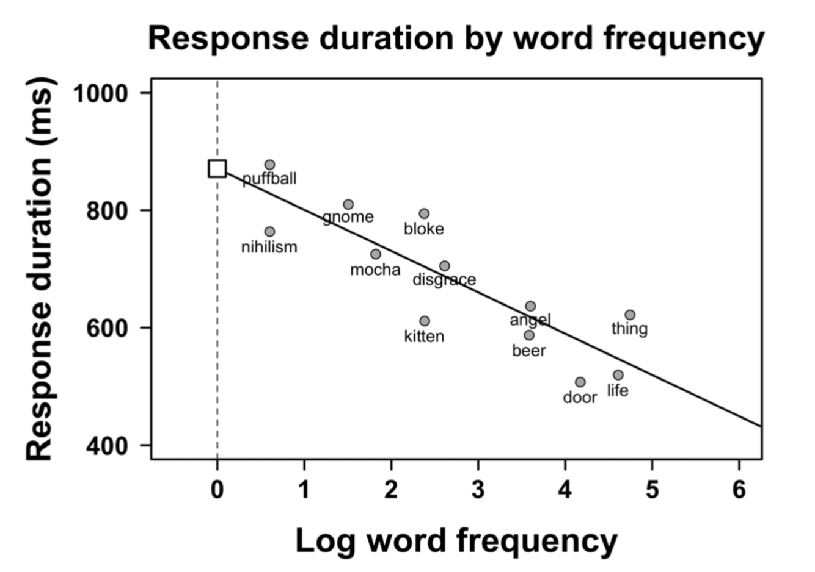
From Correlation to Simple Regression
(X, Y)
b = -70

Slide 21

From Correlation to Simple Regression
(X₁, X₂) -> (X, Y)
Line of best fit
Intercept = b₀
slope = b₁*x
$$b \text{= −70}$$

Slide 22
From Correlation to Simple Regression
(X₁, X₂) -> (X, Y)
Line of best fit
Intercept = b₀
slope = b₁*x
$$b \text{= −70}$$

Slide 23
Simple Regression: simple diagram
X₁
Y
X₁
X₁
Y
Y

Slide 24

Review: Simple Regression Mathematical Formula for a Regression Line
$$y=b_{0}+ {(b}_{1}∗x_{1})+e$$
Outcome
variable
Intercept

Slide 25

Review: Simple Regression Mathematical Formula for the Regression Line
$y=b_{0}+ {(b}_{1}∗x_{1})+e$
Slope term
Outcome
variable
Predictor
variable
Intercept
Beta
coefficient

Slide 26

Review: Simple Regression Mathematical Formula for the Regression Line
$y=b_{0}+ b_{1}∗x_{1}+e$
Slope term
Outcome
variable
Predictor
variable
Intercept
Beta
coefficient

Slide 27
Review: Simple Regression Mathematical Formula for the Regression Line
$y=b_{0}+ b_{1}∗x_{1}+e$
Slope term
Residual
Error
Outcome
variable
Predictor
variable
Intercept
Beta
coefficient

Slide 28
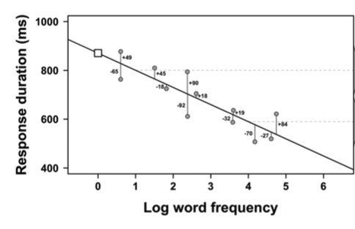

Residuals (in the error term)
$$b \text{= −70}$$

Slide 29

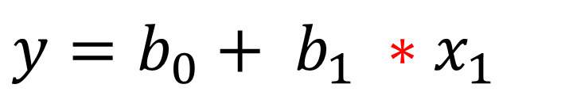
Predictions from Simple Regression
$$y=b_{0}+ b_{1} ∗x_{1}$$
$$b1 \text{= −70}$$

Slide 30
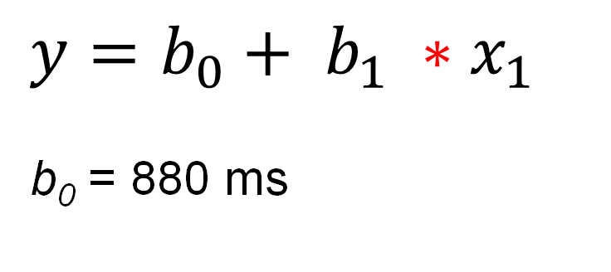
Predictions from Simple Regression
$$y=b_{0}+ b_{1} ∗x_{1}$$
b₀ = 880 ms
$$b \text{= −70}$$

Slide 31
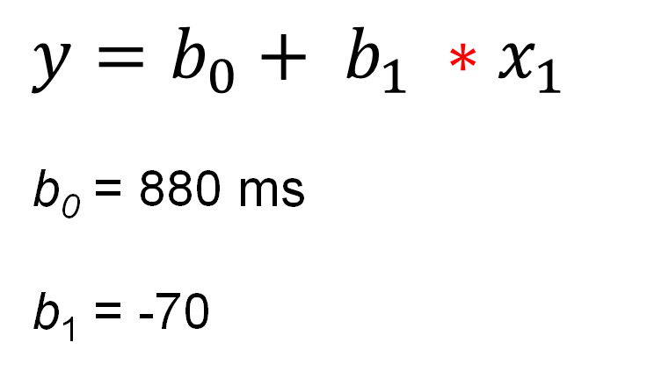
Predictions from Simple Regression
$$y=b_{0}+ b_{1} ∗x_{1}$$
b₀ = 880 ms
b₁ = -70
$$b \text{= −70}$$

Slide 32
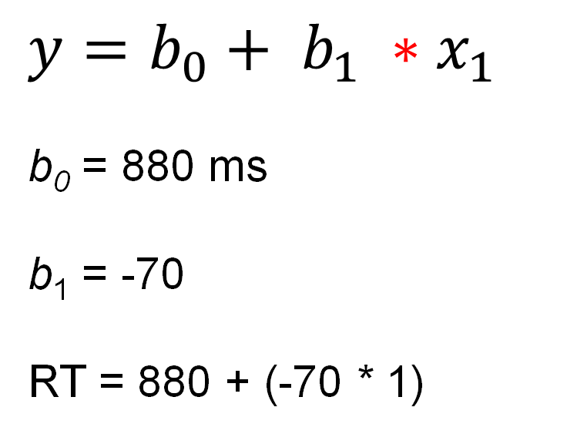
Predictions from Simple Regression
$$y=b_{0}+ b_{1} ∗x_{1}$$
b₀ = 880 ms
b₁ = -70
RT = 880 + (-70 * 1)
$$b \text{= −70}$$

Slide 33
Predictions from Simple Regression
$$y=b_{0}+ b_{1} ∗x_{1}$$
b₀ = 880 ms
b₁ = -70
RT = 880 + (-70 * 1)
$$b \text{= −70}$$
The response time for a word of log frequency 1 = 810 ms

Slide 34
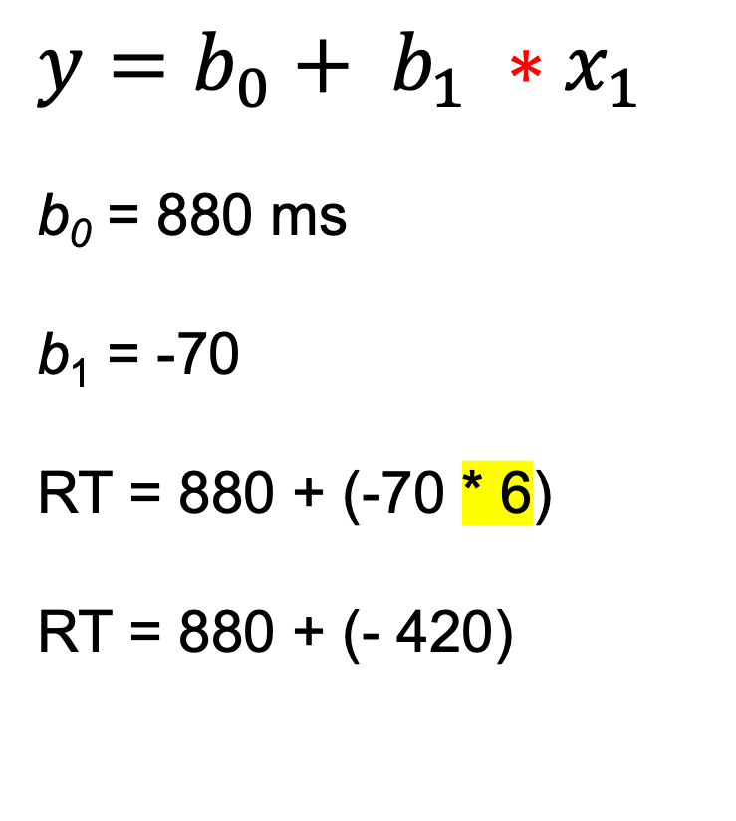
Predictions from Simple Regression
$$y=b_{0}+ b_{1} ∗x_{1}$$
b₀ = 880 ms
b₁ = -70
RT = 880 + (-70 * 6)
RT = 880 + (- 420)
$$b \text{= −70}$$
The response time for a word of log frequency 6 = 460 ms

Slide 35
Review: Simple Regression – Assumptions
Linearity for the relationship between Y and X
Independence of observations – you could scramble a dataset and the findings would not change
Homoscedasticity of residuals
Normally distributed residuals

Slide 36
Review: Simple Regression – Model Fit
Coefficient of Determination: R²
Null model
intercept and error term only
y = b₀ + e
Hypothesised model
intercept, predictor and error
y = b₀ + b₁*x₁ + e
$$R^{2}=1 − \frac{{SSE}_{model}}{{SSE}_{null}}$$

Slide 37
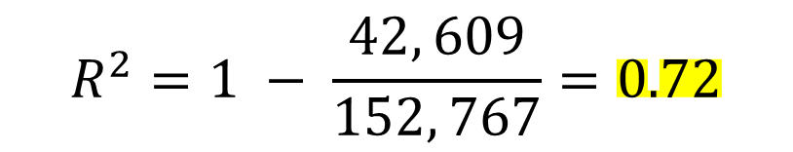
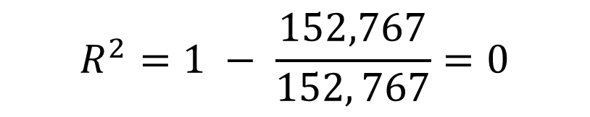
Review: Simple Regression – Model Fit
Null model
intercept and error term only
y = b₀ + e
SSE_{null} = 152, 767
Hypothesised model
intercept, predictor and error
y = b₀ + b₁*x₁ + e
SSE_{model} = 42, 609
$$R^{2}=1 − \frac{152,767}{152, 767}=0$$
$$R^{2}=1 − \frac{42, 609}{152, 767}=0.72$$

Slide 38
Simple Regression: Interpreting the output
Interpretation of Intercept term (b0)
Average when all continuous predictors are at 0 or categorical predictors are at their reference level
Interpretation for continuous coefficients =
A one unit increase in X gives a change in Y by the amount of b
Interpretation for categorical coefficients =
A change to another level or group within X gives a change in Y by the amount of b

Slide 39
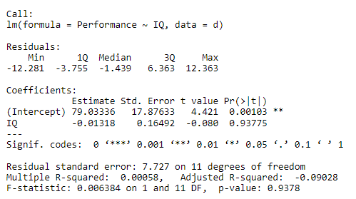
Simple Regression Model Summary in R

Slide 40
From Simple to Multiple Regression
There are more predictor variables
Some additional work in preparing the dataset for analysis
Still one intercept
Some minor differences in interpretation for the intercept
Still one error term
Some additional detail for the interpretation and reporting of predictor variables

Slide 41
Simple Regression: simple diagram
X₁
Y

Slide 42
Simple Regression: simple diagram
X₂
X₁
Y
X₂
X₁
Y

Slide 43
From Simple to Multiple Regression
Several predictors
Y = Intercept + predictor 1 + predictor 2 + Error
Y = b₀ + b₁ * X₁ + b₂ * X₂ + e
Interpretation of Intercept term (b₀)
Average when all continuous predictors are at 0 and categorical predictors are at their reference level
Interpretation for continuous coefficients =
A one unit increase in X₁ gives a change in Y by the amount of b_{1,} when all other predictors are held constant / at their reference level
A one unit increase in X₂ gives a change in Y by the amount of b_{2,} when all other predictors are held constant / at their reference level
...

Slide 44
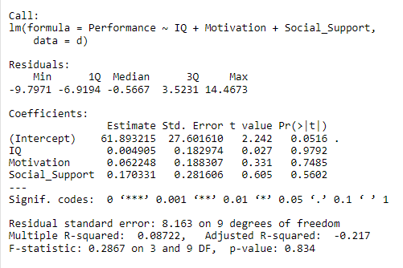
Multiple Regression Model Summary in R
Additional predictors

Slide 45
RStudio Demonstration

